Slide 1
Portfolio Optimization Analysis
Group 4

Slide 2
Introductions
Jason McCoy
Dennis Pfeiffer
Matthew Ward

Slide 3
Problem
We are exploring Portfolio Optimization. While various methods and goals exist, the common objective is to identify an optimal set of investments for a portfolio. We are exploring various objectives and models to create a portfolio from ten DOW Industrial stocks.
Why we chose Portfolio Optimization?
Large amounts of data – This makes this area of study very accessible
Many Different models to compare - Opportunities to try different methods and tools
Opportunities to adjust Objectives – Interesting to explore the same data with different objectives
Risk Sensitivity - Portfolio Optimization is a good example of other analysis problems involving risk
You can use this stuff to make money!

Slide 4
Objectives
The objective of portfolio optimization is to seek the best trade off between the risk of potential loss and the best potential returns. This is achieved by controlling the mean variance of the portfolio, using the concept of covariance between potential investments (portfolio optimization, 2013). In our project we are trying to find a minimum risk portfolio with maximum returns within our selected stock pool.

Slide 5
Challenges and Assumption
This type of analysis has several shortcomings, some of these can be controlled through assumptions, but generally the analysis requires a great deal of personalization and in the end only aids in the management of risk. Further this model falls well short of predicting market behavior and is only reliable, given relatively constant conditions.
Individual factors such as portfolio size, investment horizon and individual preferences are not accounted for(J.C. Duan et al.(eds), p676).
Assumes consistent behavior of the market and that all variances are normally distributed.
Transaction cost and taxes are not accounted for.

Slide 6
Models
We created several models from the same data set. We looked at ten DOW stocks over the last five year period as the data for our potential portfolios. We used both Excel Solver and R to formulate different models currently in use in the financial industry. These models optimized a portfolio based on maximizing return on investment, minimizing variance and maximizing utility
Models
Markowitz in Excel Solver
Sharpe Ratio in Excel Solver
Mean Return with ROI in R
Minimize Variance with ROI in R
Maximize Quadratic Utility with ROI in R

Slide 7
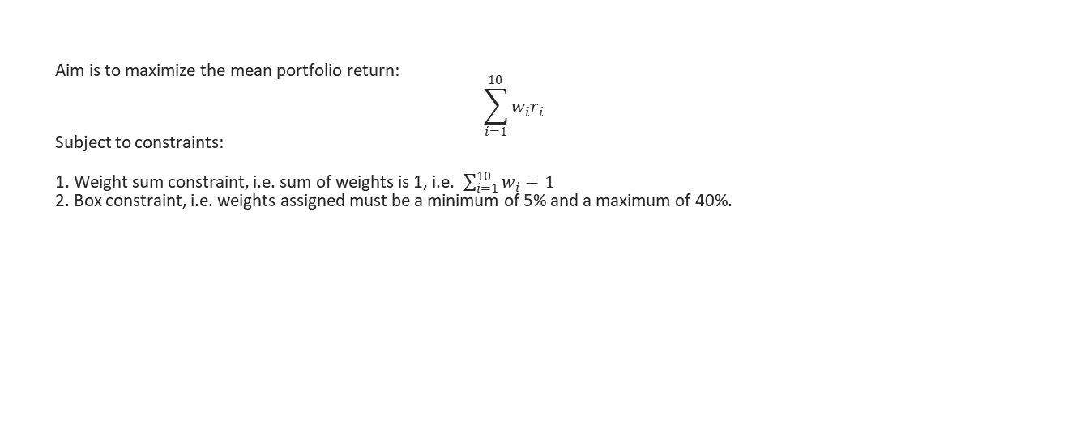
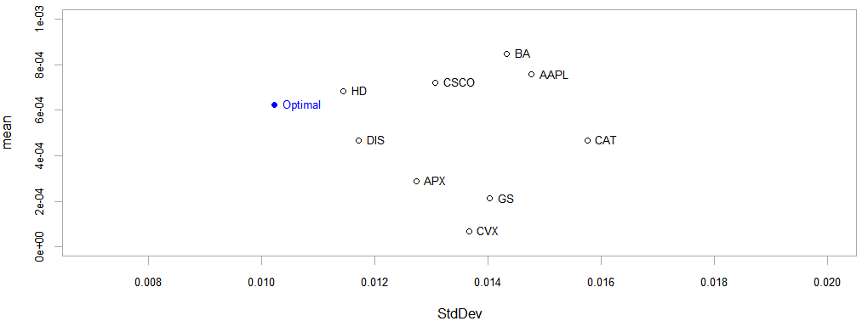
Model 1: Maximizing Portfolio Expected Return
AAPL | 20%
APX | 5%
BA | 40%
CAT | 5%
CSCO | 5%
CVX | 5%
DIS | 5%
GS | 5%
HD | 5%
IBM | 5%
Notes:
wi is the weight for each portfolio and ri is the return for each portfolio. The constraints are self explanatory. The allocation of percentages after optimization in R is shown on the left table. For graph, the 10 portfolios are marked based on their mean return in y-axis and standard deviation in x axis.

Slide 8
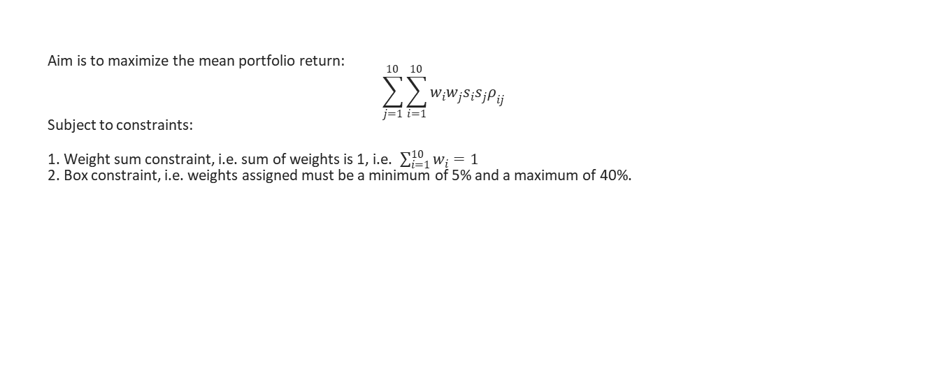
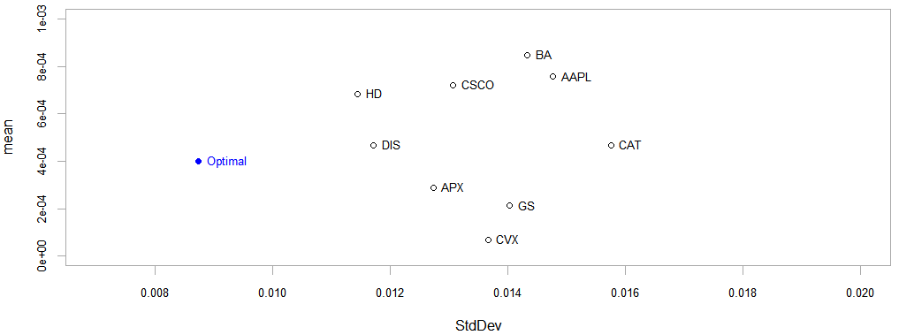
Model 2: Minimizing Portfolio Variance
AAPL | 6.89%
APX | 10.66%
BA | 5%
CAT | 5%
CSCO | 5%
CVX | 9.05%
DIS | 18.88%
GS | 5%
HD | 20.79%
IBM | 13.73%
Notes:
wi is the weight for each portfolio and si is the standard dev for each portfolio. Rho is the correlation between returns of two portfolio. The constraints are self explanatory. The allocation of percentages after optimization in R is shown on the left table. For graph, the 10 portfolios are marked based on their mean return in y-axis and standard deviation in x axis. Compare how the optimal point changes. Compared to model 1, model 2 has lower return and lower risk.

Slide 9
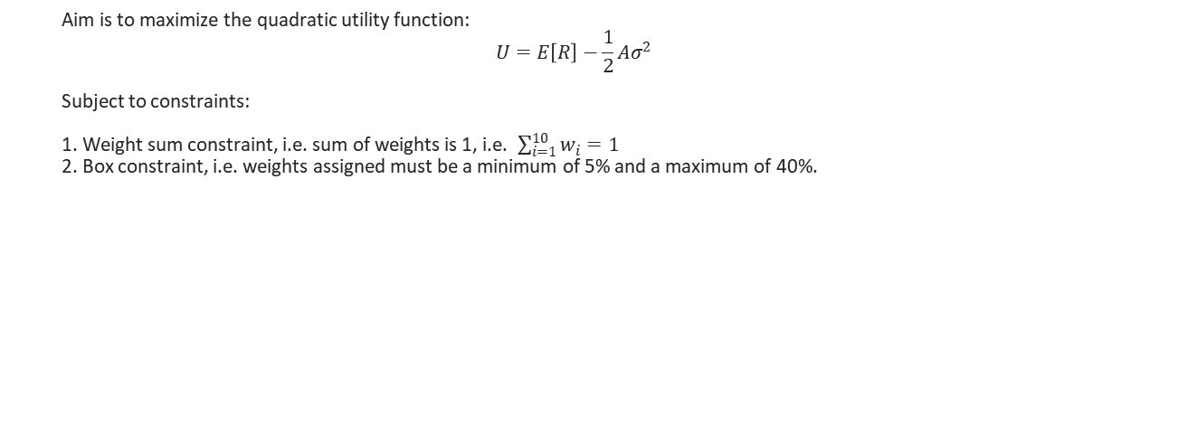

Model 3: Maximizing Quadratic Utility
Risk aversion = 0.25
AAPL | 20%
APX | 5%
BA | 40%
CAT | 5%
CSCO | 5%
CVX | 5%
DIS | 5%
GS | 5%
HD | 5%
IBM | 5%
Notes:
R is the portfolio return and sigma is the portfolio standard deviation (or the risk measure). Hence, both return and risk goes into the objective function. By maximizing utility function, we are trying to maximize return and minimize variance. Another way to incorporate both risk and return in objective function is using the Sharpe Ratio which will be discussed in the next model.

Slide 10
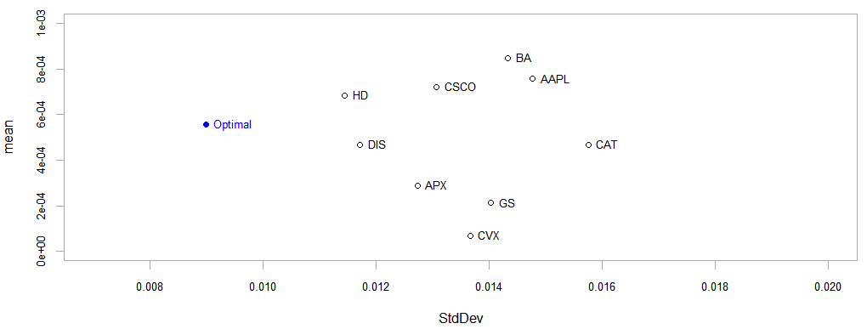
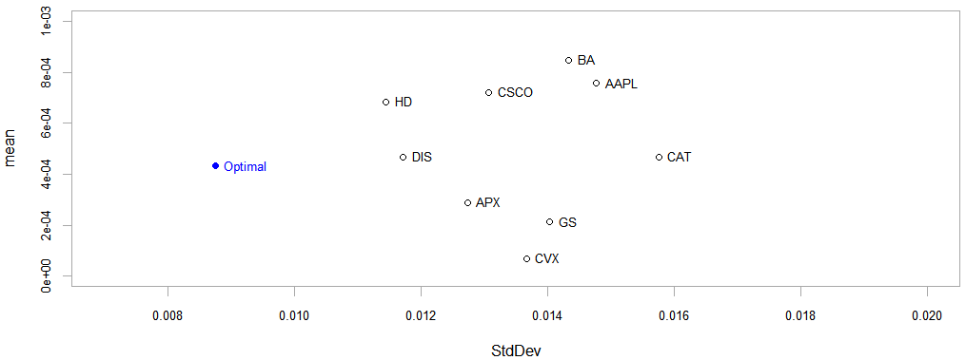
Risk aversion = 10
AAPL | 11.86%
APX | 5%
BA | 10.93%
CAT | 5%
CSCO | 10.62%
CVX | 5%
DIS | 12.68%
GS | 5%
HD | 29.92%
IBM | 5%
Risk aversion = 100
AAPL | 8.14%
APX | 10.44%
BA | 5%
CAT | 5%
CSCO | 5%
CVX | 8.22%
DIS | 19.52%
GS | 5%
HD | 22.89%
IBM | 10.79%
Notes:
We observe that as the risk aversion increase from 0.25 to 10, the standard deviation decreases and also the mean return decreases. Going from risk aversion of 10 to 100, the trend is the same, however, the decrease in standard deviation is relatively less. Thus, more risk averse individual will chose a portfolio which has lower standard deviation (risk measure) but that would also result in lower mean return of the portfolio.

Slide 11
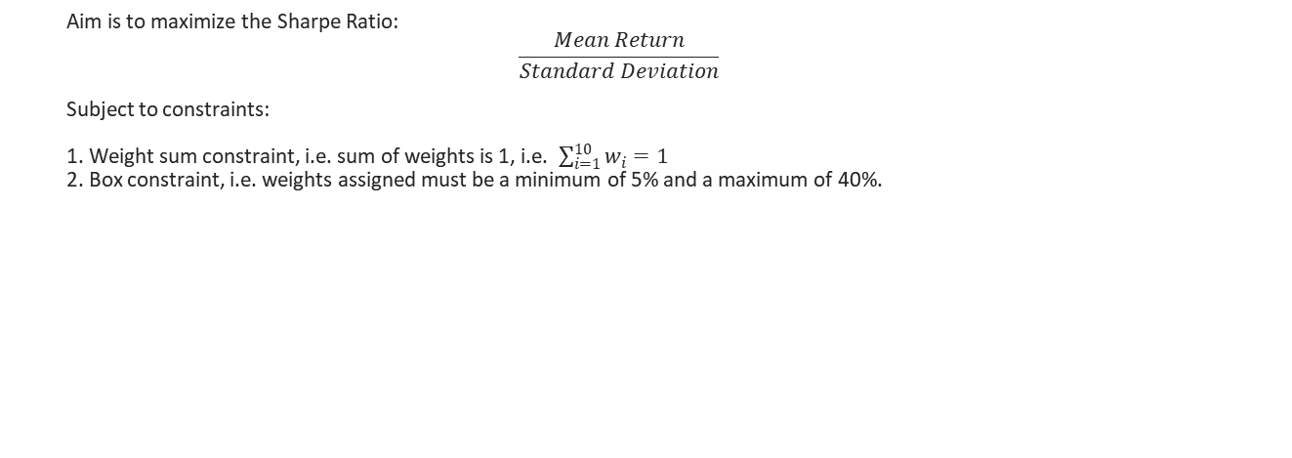
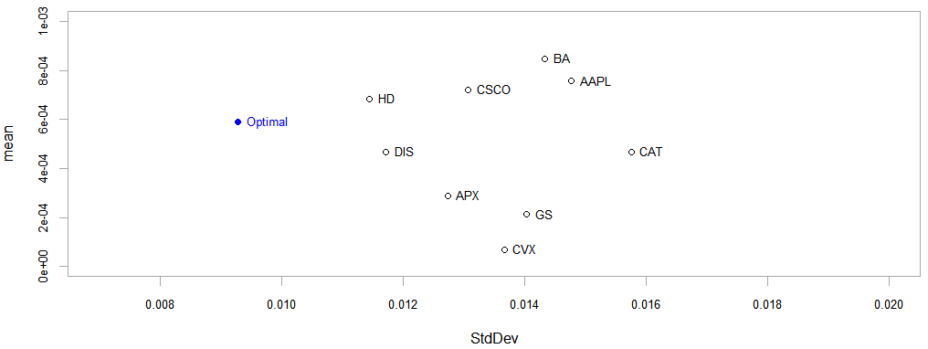
Model 4: Maximizing Sharpe Ratio
AAPL | 13.80%
APX | 5%
BA | 20.76%
CAT | 5%
CSCO | 10.72%
CVX | 5%
DIS | 5%
GS | 5%
HD | 24.73%
IBM | 5%
Notes:
Sharpe ratio is defined as the mean return per unit of standard deviation. Maximizing Sharpe ratio would mean making numerator (mean return) as high as possible and making denominator (risk) as low as possible.

Slide 12
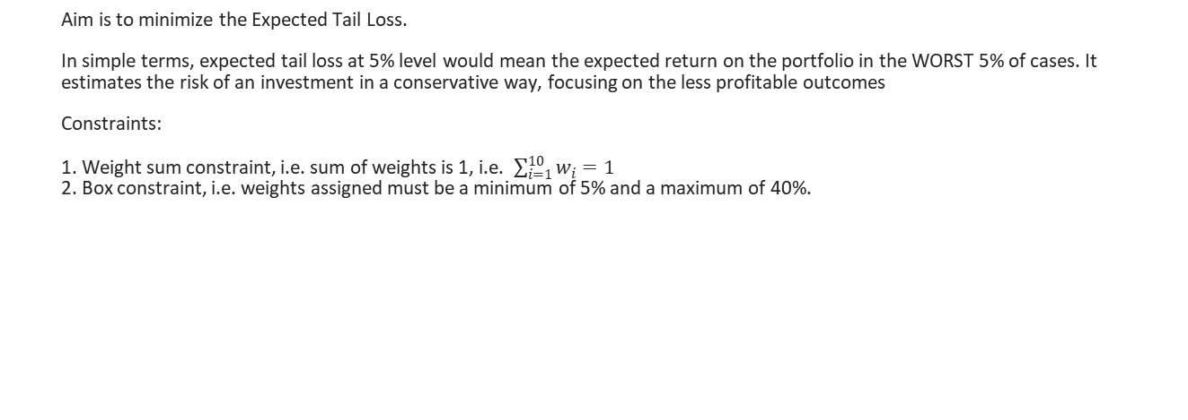
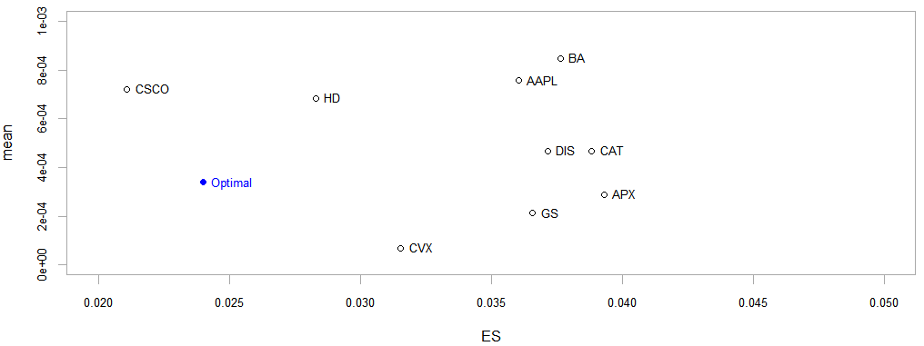
Model 5: Minimizing Expected Tail Loss (or Conditional VaR)
AAPL | 5%
APX | 5.55%
BA | 5%
CAT | 5%
CSCO | 5%
CVX | 13.1%
DIS | 15.7%
GS | 5%
HD | 20.25%
IBM | 20.4%
Notes:
Read from slide.
Refer Section 3.2 of https://arxiv.org/pdf/1511.00140.pdf
Despite revolutionizing risk management at its time, the Markowitz Model has some drawbacks regarding risk management. Two important disadvantages arise because it measures the risk in terms of variance of the portfolio: 1. Variance is only a useful risk measure for normally (or symmetrically) distributed losses. Since variance is measured in either direction, tail losses arising from skewed loss distributions are not taken in account. 2. Variance is not a coherent risk measure as it is not monotone.
Hence, this model is more appropriate.
In the diagram, note that x-axis is no longer standard deviation, but is ES (Expected shortfall, another name for expected tail loss or conditional value at risk)

Slide 13
Results and Future Work
Our results provide a tool for minimizing risk in a potential portfolio. These methods allow us to make more well informed investment choices that we would have with a gut approach.
These results do however, not represent a real prediction of returns. They also do not include several important factors such as taxes, transaction fees and potential market behavior.
In future work we would incorporate taxes, transaction fees, dividends and other factors into the model. Different risk profiles and investment horizons could be modeled to provide bounds of potential downside risk to potential portfolios.

Slide 14
References
portfolio optimization. (2013). In D. Rutherford, Routledge Dictionary of Economics (3rd ed.). London, UK: Routledge. Retrieved from http://turing.library.northwestern.edu/login?url=https://search.credoreference.com/content/entry/routsobk/portfolio_optimization/0?institutionId=631
Duan, J. C. et al. (eds.), Handbook of Computational Finance, Springer Handbooks of Computational Statistics, DOI 10.1007/978-3-642-17254-0 25, © Springer-Verlag Berlin Heidelberg 2012

